Slide 1

Water Quality Affecting Real World
Team-4
Junaid Mohammed (G01386670)
Koustav Roy (G01340428)
Sravani Pulusu (G01403752)
Sreeja Badri (G01352310)
Vaishnavi Kadapathri (G01351803)
Course: AIT614
Section: DL1
Professor Dr. Duoduo Liao
George Mason University
Date: 04/26/2023

Slide 2
Overview
Introduction
Objectives
Project Timeline
Architecture of the System
Dataset
Exploratory Data Analysis
Development Platforms and Algorithms
Feature Scaling
Accuracy
Conclusion
References

Slide 3
Introduction:
An essential commodity is water, especially if you own a home. However, water quality can change over time, and well water is especially susceptible to this. Sadly, not all of these changes are beneficial.
In addition, previously safe and clean water may now contain impurities like iron, manganese, nitrates, or strange PH levels that can be dangerous to human health, impair the performance of appliances, damage clothing, and cause other issues.
The country's water supply and water quality have improved over the last 50 years, yet problems still exist.
For safeguarding the health of people, the ecosystem, and the economy of the country, access to clean and safe water is crucial. Despite improvements over the previous 50 years, the country's drinking water's safety and quality are still in danger.

Slide 4
Objectives
How do other indicators of water quality and pH connect to one another?
What year has a higher pH?
Comparing all the variables which has the highest level of water?
When do the effects of the water quality variables become less and more noticeable?
How does water quality affect air and water temperature variations?

Slide 5
Project Timeline
Project Proposal
Junaid
Koustav
Sravani
Sreeja
Vaishnavi
Project abstract
Junaid
Sravani
Working System
Junaid
Koustav
Sravani
Sreeja
Vaishnavi
Project Reflection
Junaid
Koustav
Sravani
Sreeja
Vaishnavi
Project Presentation
Koustav
Sreeja
Vaishnavi

Slide 6
Architecture of the System
Dataset
Data.gov
Data bricks
Data Storage
MongoDB with Python
Loading
Data
Storing
Data
Using the Stored Data
Data Analysis and Modeling
Data Preprocessing
Data Cleaning
Visualization
Building Models
Result
Comparing the Accuracy of
the Models

Slide 7
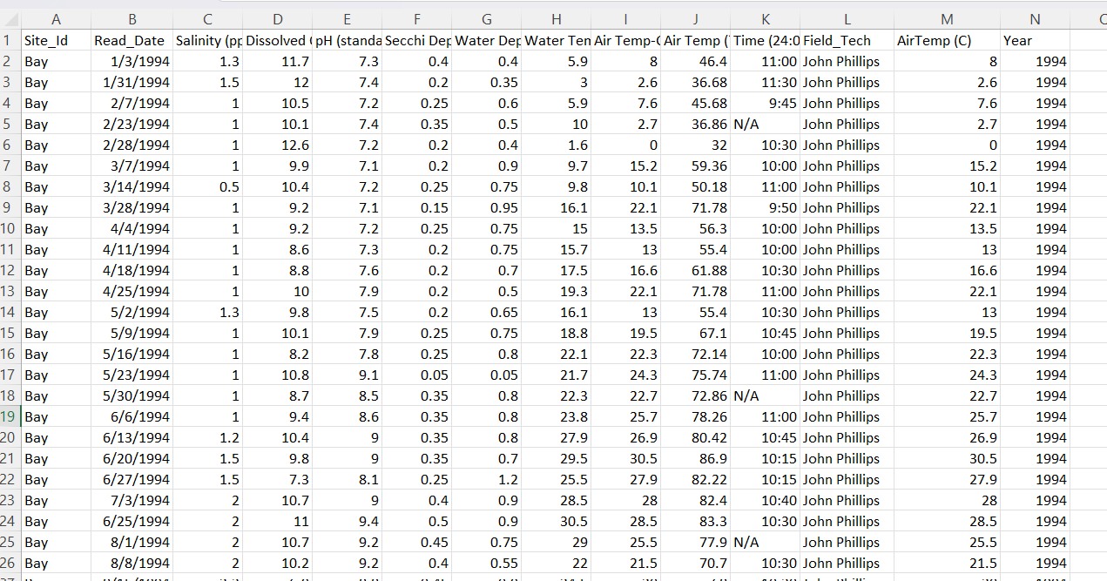
Dataset

Slide 8
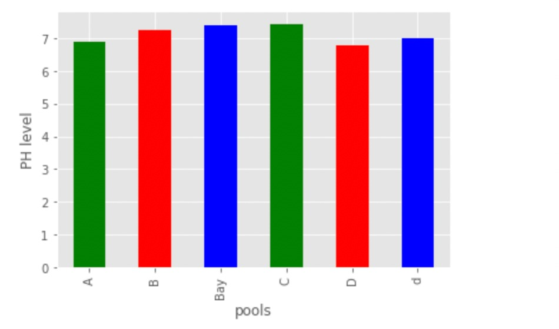
Exploratory Data Analysis

Slide 9
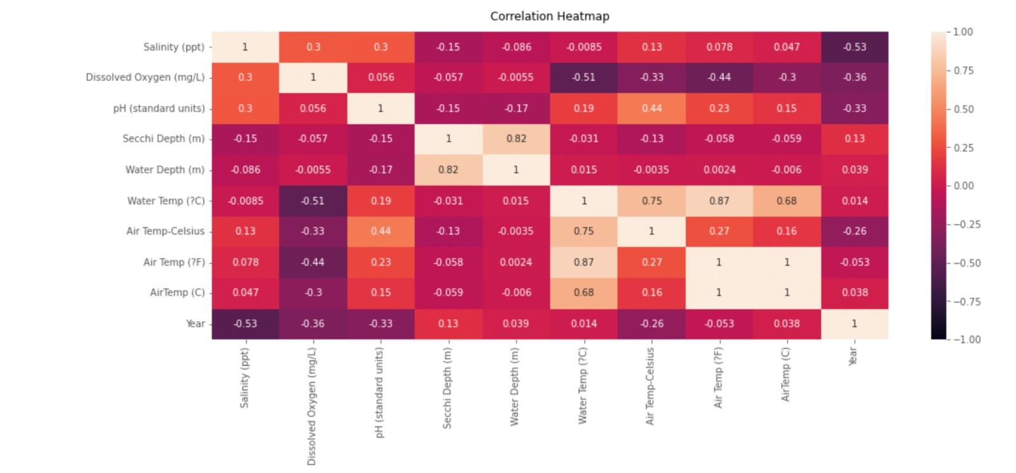
Correlation

Slide 10
Development Platforms & Algorithms
NoSQL
MongoDB with Python
Spark with Python
Python on Databricks
Random Forest
KNN
Decision Tree

Slide 11
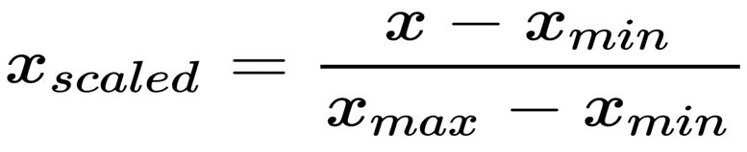
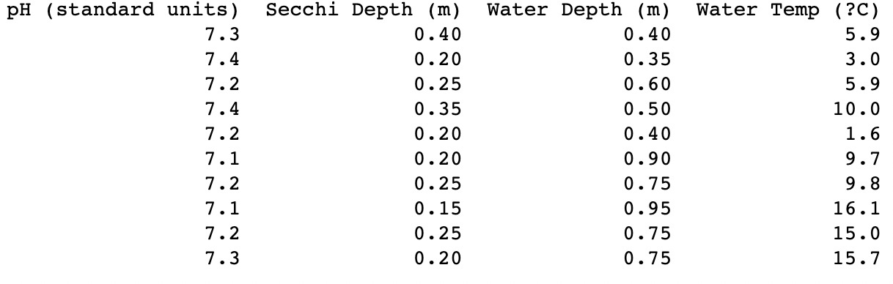
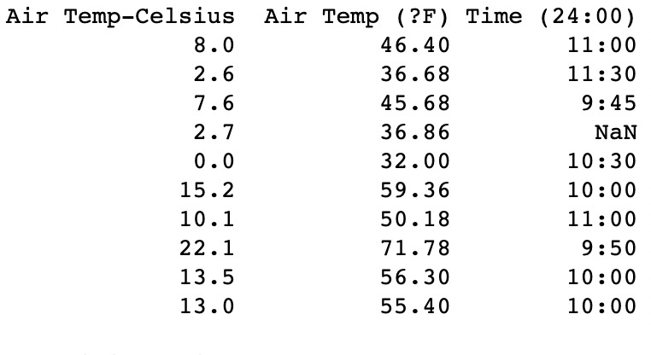
Feature Scaling
Feature scaling is performed using MinMaxScaler() function.

Slide 12
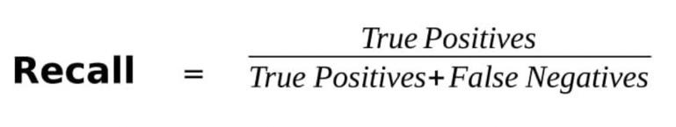
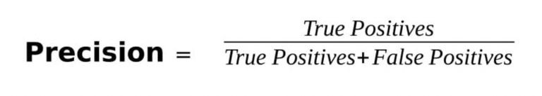
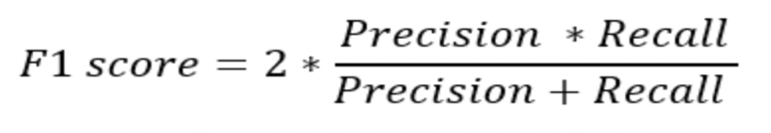
Model Evaluation Metrics
Various techniques will be used to predict accuracy.
Another evaluation metric is the F1 score. F1-score is a statistic that considers both precision and recall because we can't always compare the two and use the one with the highest score for our model.

Slide 13
Accuracy
After a detailed analysis of the performance of the algorithms
Random Forest has a better performance compared to other algorithms.
 | Model | Accuracy
1 | Random Forest | 0.878
3 | KNN | 0.831
2 | Decision Tree | 0.865

Slide 14
Conclusion
The major goal of the study is to develop features that are important for predicting water quality, determine which types of water bodies have more accurate water pH levels, and optimize the system.
It turned out that water has a higher pH level in the year 2009.
Bay has the highest water level.
In future work we will work on other modeling techniques other than KNN, Decision Tree, and Random Forest to obtain much more accurate and efficient results

Slide 15
References
Publisher Fish and Wildlife Service. (2022, October 13). Water Quality Data. Catalog. Retrieved March 19, 2023, from https://catalog.data.gov/dataset/water-quality-data-a3c08
Haghiabi, A. H., Nasrolahi, A. H., &amp; Parsaie, A. (2018, February 1). Water quality prediction using machine learning methods. Water Quality Research Journal. Retrieved March 19, 2023, from https://iwaponline.com/wqrj/article/53/1/3/38171/Water-quality-prediction-using-machine-learning
Water quality deterioration. Taylor &amp; Francis. (n.d.). Retrieved March 19, 2023, from https://www.tandfonline.com/doi/abs/10.1080/09603120410001725612

